Slide 1
Capstone Project
Airbnb Booking Analysis Team Members Biswajit Paul Shreya Pattanayak
EDA

Slide 2
Contents
Introduction
Understanding Dataset
Data Wrangling And Data Cleaning
Main Objectives
Data Analysis And Data Visualisation
Conclusion

Slide 3
Introduction
Airbnb is an online marketplace connecting travellers with local hosts. On one side, the platform enables people to list their available space and earn extra income in the form of rent. On the other, Airbnb enables travellers to book unique homestays from local hosts, saving them money and giving them a chance to interact with locals. Catering to the on-demand travel industry, Airbnb is present in over 190 countries across the world.

Slide 4
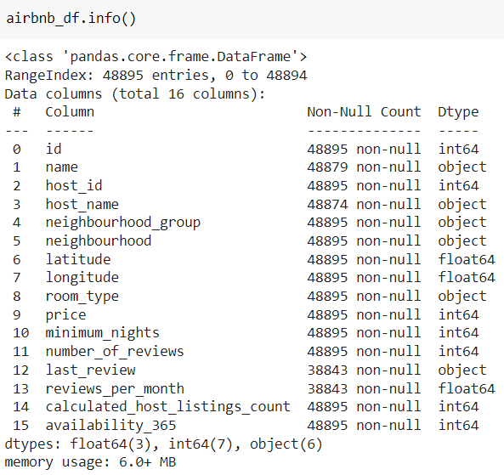
Dataset Overview
The given Airbnb dataset has total 16 columns.
There are total 48895 entries.
Data types are float64(3 columns),int64(7 columns) and
object(6 columns).
By analysing data’s and corresponding data types it is found
that all data’s are available in correct dtype except last review.
Last review should be in datetime format but we are not going
to use this column for our current EDA so lets leave it as object
dtype.

Slide 5
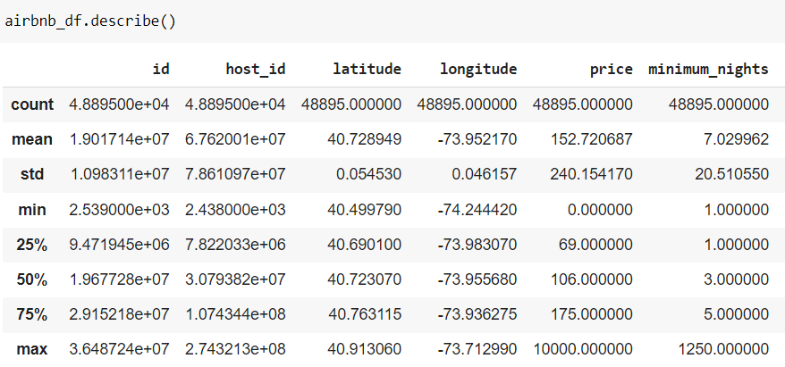
Dataset Overview(continue..)
Average price for the room is 152.7 $
On an average people stay 7 days in a room
Maximum price of the room is 10000 $
Mean review given to the room/apartment is 23.

Slide 6
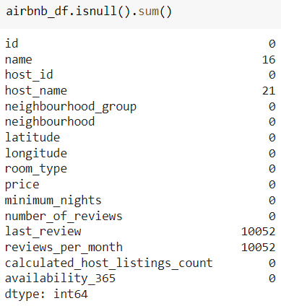
Data Wrangling
Name and host name has 12 null values
Last review and reviews per month has 10052 null values.
There we have total 4 columns with null values but "last_review" has no significance for this current EDA project. The missing values present in "reviews_per_month" can be replaced by 0.
Now lets take a look at "availability_365" column, there we can see even though availability is zero, there are some corresponding values available in "reviews_per_month" column .So that means that AirBnb reviewed some rooms having no guests yet. We can drop those values

Slide 7
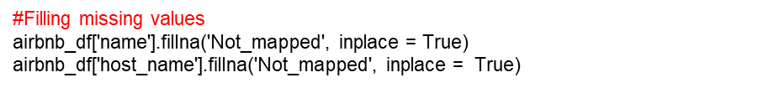
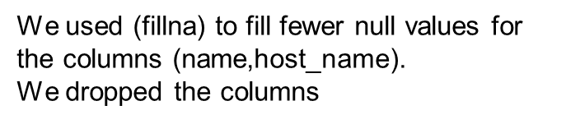

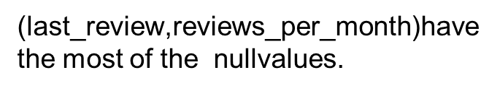
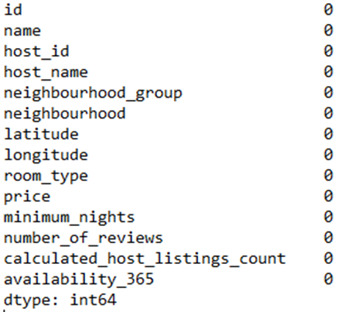
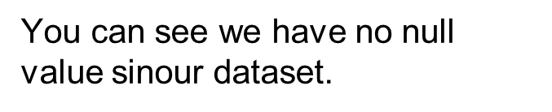
Data Cleaning

Slide 8
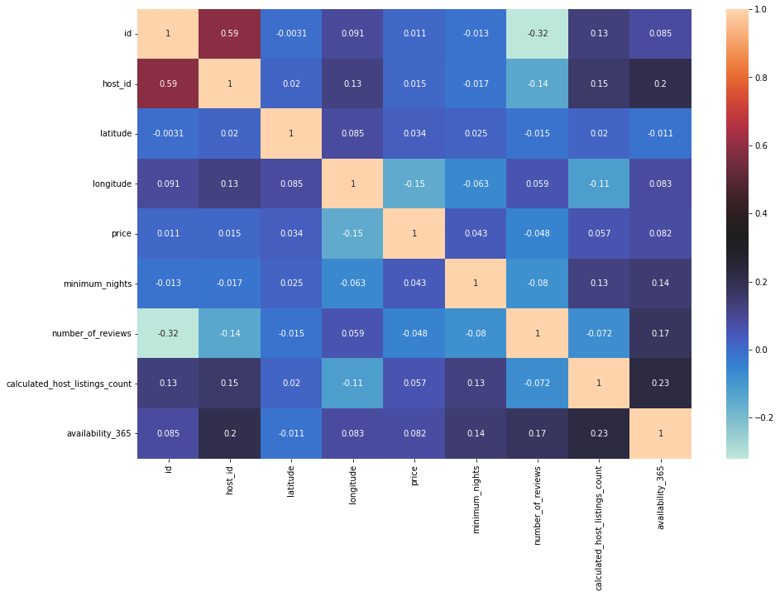
Viewing correlation of the numerical values

Slide 9
Main Objectives
What can we learn about different hosts and areas?
What can we learn from predictions? (ex: locations, prices, reviews, etc.)
Which hosts are the busiest and why?
Is there any noticeable difference of traffic among different areas and what could be the reason for it?

Slide 10
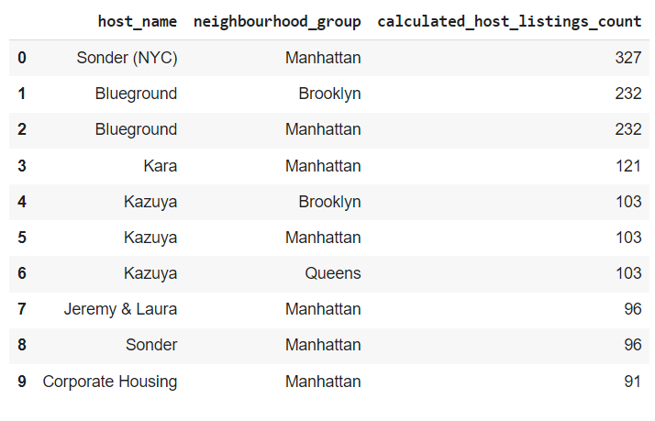
Data Analysis And Data Visualisation
From the top 10 observations according to highest calculated_host_listings_count, we can found that 7 results are from Manhattan area,2 from Brooklyn and 1 from Queens. So it is clear that AirBnb is a popular business model in Manhattan. The host who has most host_listings are sonder(NYC).

Slide 11
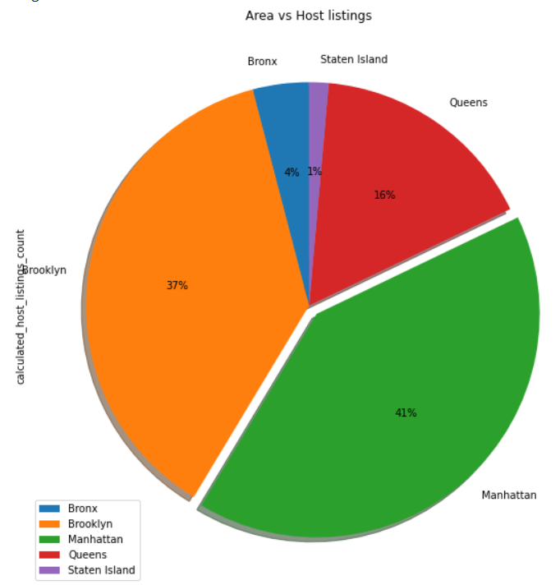
Data Analysis And Data Visualisation(cont..)
Manhattan has maximum host listings which is 41% of the entire listings, then Brooklyn has 37%,Queens has 16%,Bronx has 4% and at last Staten island has only 1% listings.

Slide 12
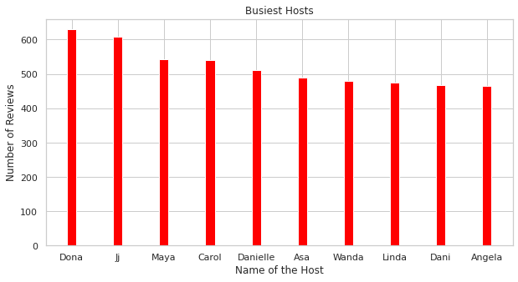
Data Analysis And Data Visualisation(cont..)
To find the busiest host we have to make an analysis on host_name versus number_of_reviews.The logic is very simple those hosts who has most number of reviews would be having most number of bookings.
From top 10 list of busiest hosts we can see that 8 results are from private room type.
The name of the busiest_host is Dona from queen area having 629 review.

Slide 13
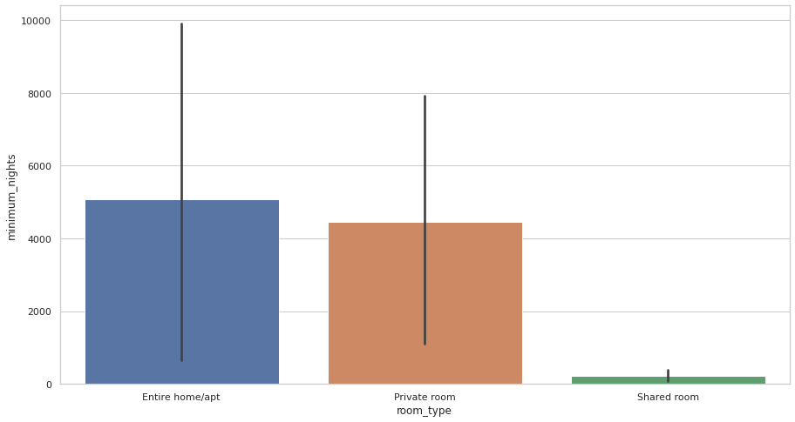
Data Analysis And Data Visualisation(cont..)
Shared rooms are very cheap as compared to Entire home/apt
Private rooms are little costlier than shared rooms
Entire home/apt is very expensive than all others.

Slide 14
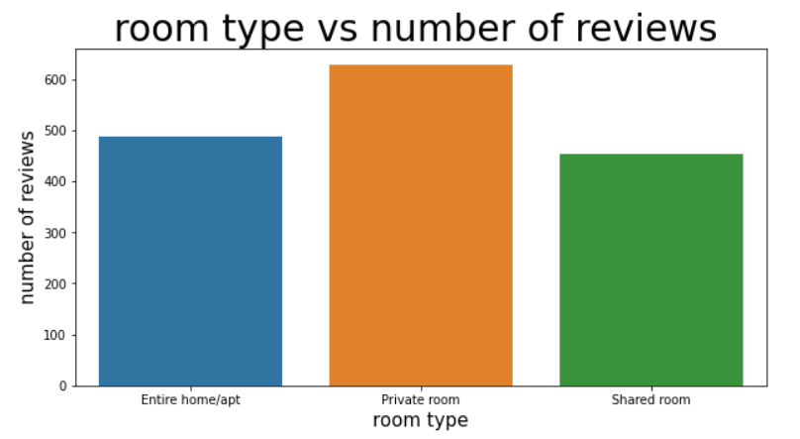
Data Analysis And Data Visualisation(cont..)
Even though shared rooms are much cheaper as compared to private rooms most reviews are for private rooms which means that most number of people prefer private rooms over other room type. Probably couples or small group of peoples who need more privacy and prefer budget friendly stay will go for private rooms, so we can say that most of the AirBnb customers are from this category.

Slide 15
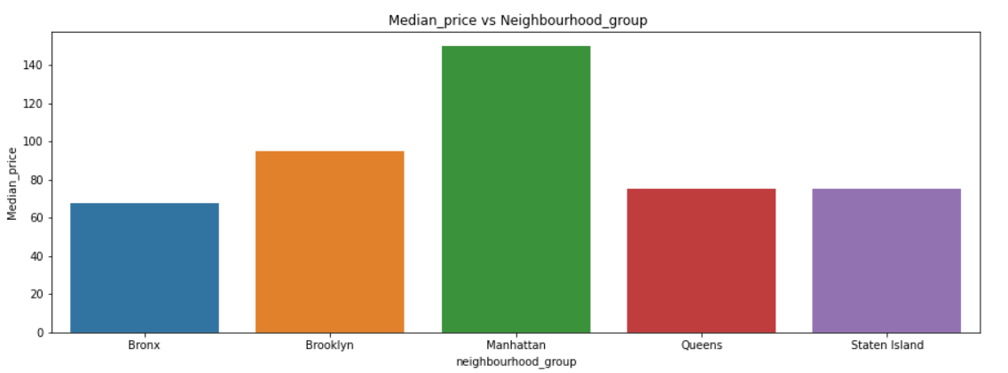
Data Analysis And Data Visualisation(cont..)
'Manhattan' is the area having highest median price, followed by Brooklyn. So we can say that most costly hosts are situated in "Manhattan".

Slide 16
Data Analysis And Data Visualisation(cont..)
Some Observations From graph of “Neighbourhood group vs availability”
Room availability is high in "Staten Island" ,the average value shows that rooms are available for 246 days in each year.
Room availability is very low in "Brooklyn", as per available data rooms are available only for 93 days in each year.
From the previous observations we found that maximum host listings are in "Manhattan area" but room availability is very low as compared to other areas that means number of people visiting "Manhattan" is more than available rooms. Which creates high demands for rooms and that's the reason for high price.

Slide 17
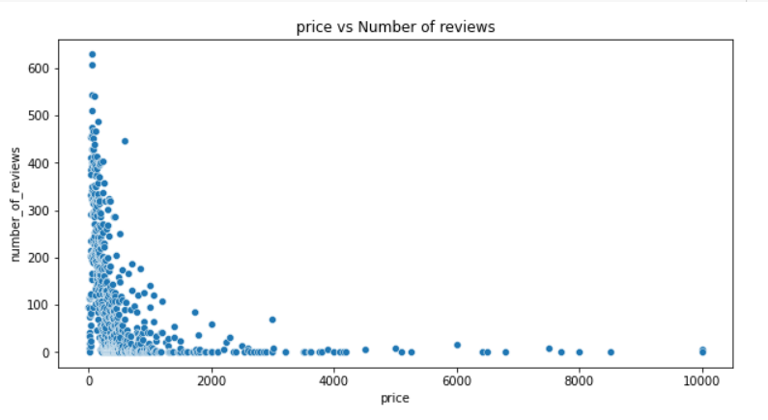
Data Analysis And Data Visualisation(cont..)
Number of reviews are more at low price and reviews decreasing when price increases.
From the scatterplot it is clear that most number of people prefer budget friendly rooms.

Slide 18
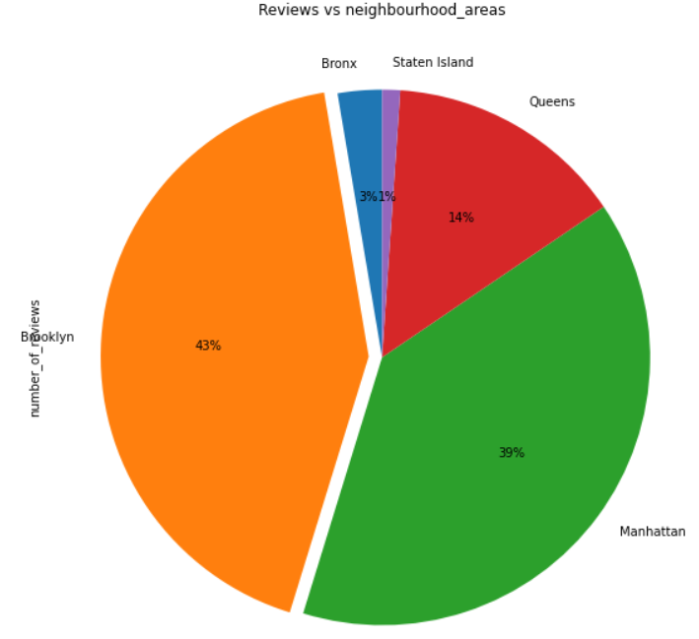
Data Analysis And Data Visualisation(cont..)
From the previous observations we seen that maximum host listings are in "Manhattan area" and "Brooklyn" but room availability is very low in both these areas that means number of people visiting these areas are high. To strengthen this assumption lets do some more analysis based on number of reviews in different neighbourhood areas.
From the diagram it is clear that both "Manhattan" and "Brooklyn" has got most number of reviews which strengthen our assumption that these areas are having high traffic.

Slide 19
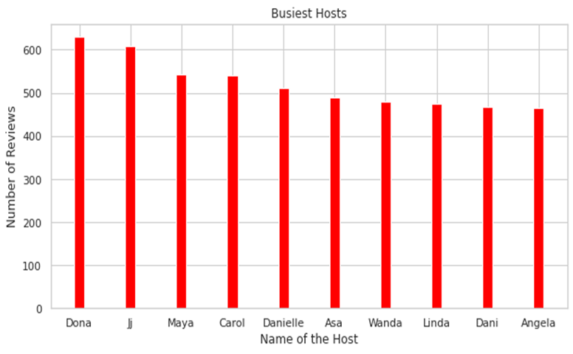
Data Analysis And Data Visualisation(cont..)
From this top 10 results it is also very clear that neighbourhoods belongs to "Brooklyn and "Manhattan" has got more reviews.
“Bedford-Stuyvesant” belongs to “Brooklyn” has got more reviews which means more traffic in this particular area.

Slide 20
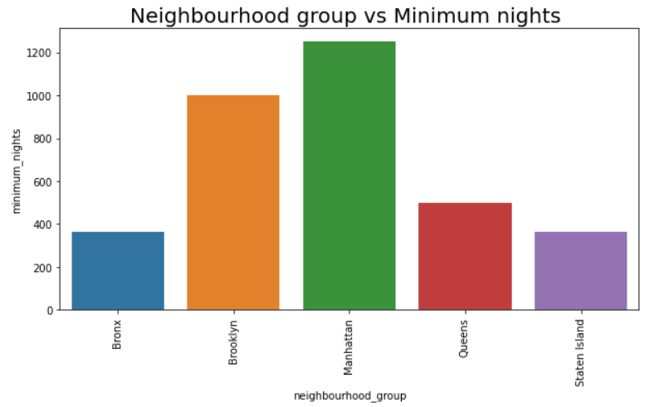
Data Analysis And Data Visualisation(cont..)
From minimum nights data,it is clear that people like to spend more days in "manhattan" and "brooklyn".
From all these last three observations based on review,minimum nights and availability, we can say in “Manhattan” and “Brooklyn” has more traffic

Slide 21
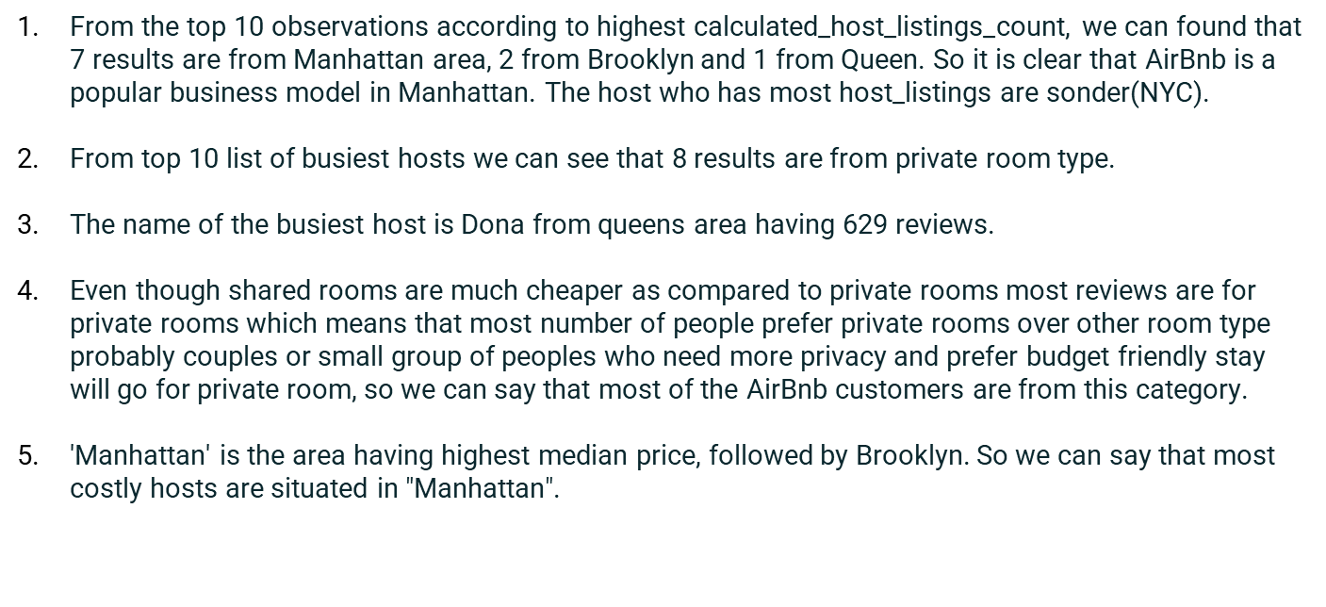
Key Findings

Slide 22
Key Findings(cont..)
Room availability is high in "Staten Island" ,the average value shows that rooms are available for 246 days in each year.
Room availability is very low in "Brooklyn", as per available data rooms are available only for 93 days in each year.
From the previous observations we found that maximum host listings are in "Manhattan area" but room availability is very low as compared to other areas that means number of people visiting "Manhattan" is more than available rooms. Which creates high demands for rooms and that's the reason for high price.
From the scatterplot it is clear that most number of people prefer budget friendly rooms.
by analysing available data of "numbers_of_reviews", "minimum nights" we found "Manhattan" and "Brooklyn" are the high traffic areas.

Slide 23
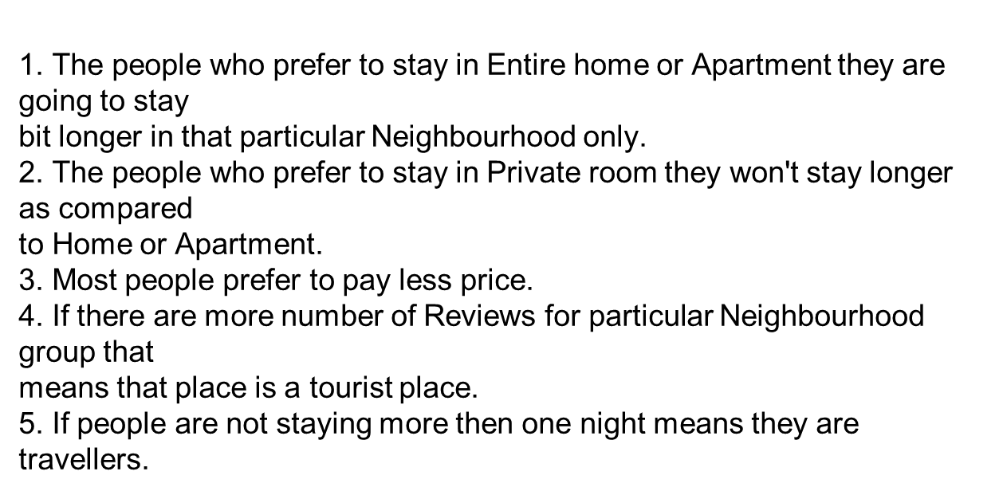
Conclusion

Slide 24
THANK YOU

